Slide 3
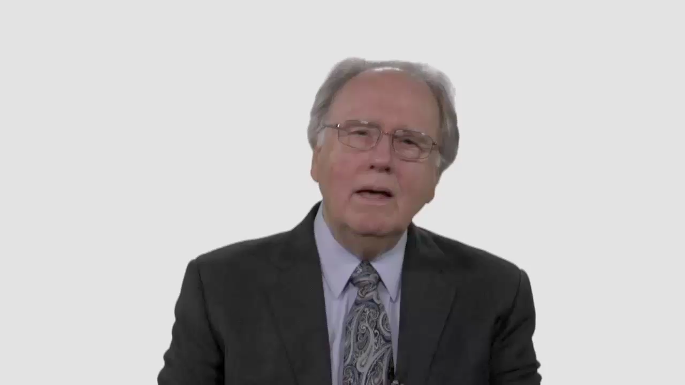

Slide 4
Have Your Say.
Apart from Scripture, what other factors may have influenced your opinion about how Adventists
should relate to homosexuality?

Slide 5
Conversation Builders.
How could 91% of non-Christians chose the term anti-homosexual as best describing the Christian faith?

Slide 6
Conversation Builders.
How would you explain the Adventist Church’s stance on homosexuality while also communicating Christ’s unequivocal love for every person?

Slide 7
Conversation Builders.
If Christians choose to fight a
cultural war against gays, will they
lose a generation of young people?

Slide 8
Discussion Questions.
Is it helpful to remember the phrase “hate the sin, love the sinner” in relation to homosexuality?

Slide 9
Discussion Questions.
What does “loving the sinner”
require in this context?

Slide 10
Discussion Questions.
Do you think gays would find your church a welcoming environment?

Slide 11
Discussion Questions.
Would your congregation be a safe place for a young person struggling with homosexuality to find guidance?

Slide 12
Discussion Questions.
Do Adventist Christians have
a duty to speak up about
gay rights issues?

Slide 13
What Now?
Why do you think sinners were comfortable in Jesus’ presence?

Slide 14
What Now?
What changes in attitude or
practices would help your church
better reflect Christ’s example?

